Slide 1
NUMBER THEORY
Why ??
Design of Public key cyptographic algorithms

Slide 2
Prime Numbers
p>1,integer
iff divisors +1 ,-1, +p or –p

Slide 3
Prime factorization
Finding which prime numbers multiply together to make the original number.
2 12
2 6
3
12=2^2 *3

Slide 4
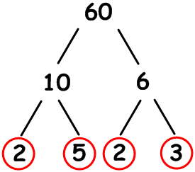
Prime factorization

Slide 5
Fermats Theorem
If p is prime and a is a positive integer not
divisible by p, then
a^p-1 1 (mod p)
OR
a^p a (mod p)

Slide 6
